Slide 1
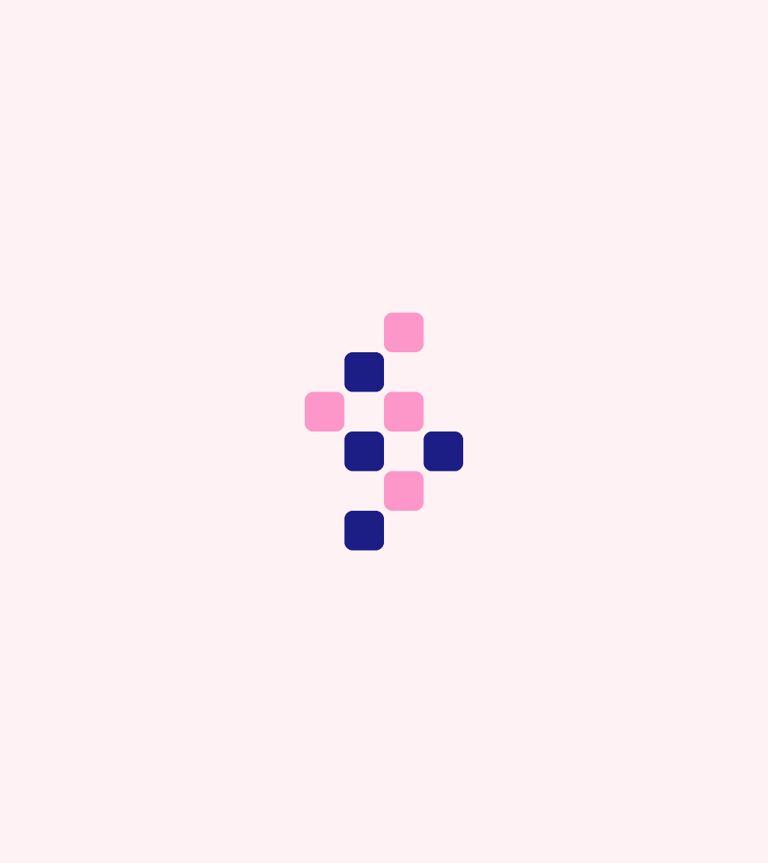

Brand Guidelines
2026 – Version 1

Slide 2
Logo
01

Slide 3



Slide 4





Primary logo clearspace is defined by the JotPsych helix logomark (x)/2.
This is the minimum amount of space required to avoid conflicts with other elements and legibility issues.
= x
= x/2

Slide 5



Slide 6

Primary logo clearspace is defined by the JotPsych helix logomark (x)/2.
This is the minimum amount of space required to avoid conflicts with other elements and legibility issues.
= x
= x/2

Slide 7



These square logo marks can be used across social media, or as logos where the primary or secondary logo lockups face legibility issues or aren’t suitable to use.

Slide 8




Logo mark clearspace is defined by the JotPsych mark (x)/2.
This is the minimum amount of space required to avoid conflicts with other elements and legibility issues.
= x
= x/2

Slide 9


These scaling recommendations give you the know-how to use each logo lock-up in it’s most effective way.
These recommendations will ensure JotPsych stands out, no matter the medium.
Primary logo
Minimum size: 160px wide
Secondary logo
Minimum size: 80px wide
Logo mark
Minimum size: 32px high

Slide 10






Using the logo as it was intended consistently across the identity will establish a cohesive look and feel.
Here are examples of what not to do,
to avoid logo misuse.
Don’t apply strokes to logo
Don’t apply effects to logo
Don’t resize or alter layout of logo
Don’t slant or skew logo
Don’t use colors outside of branding
Don’t mix and match colors

Slide 11
Typography
02

Slide 12
Archivo
Headings & Paragraphs
Google Typeface

Slide 13
Archivo is a grotesque sans serif typeface family originally designed for highlights and headlines. This family is reminiscent of late nineteenth century American typefaces. The technical and aesthetic characteristics of the font are both crafted for high performance typography.
Archivo should be used for headings and subheadings.
Regular
Medium
Italic

Slide 14
Inter
Paragraphs & Body Text
Google Typeface

Slide 15
Inter is a variable font family carefully crafted & designed for computer screens, created by Rasmus Andersson and Principal design.
Inter should be used primarily for paragraph style or body text, and not for headings or large subheadings.
Regular
Medium
Semibold

Slide 16
Color
03

Slide 17
Primary colors – these are used in logo variations, and will be used across all media.
Midnight
Warm Light
Sunset Glow
Hex:
#1C1E85
Hex:
#FFF2F5
Hex:
#FD96C9
RGB:
RGB (28, 30, 133)
RGB:
RGB (255, 242, 245)
RGB:
RGB (253, 150, 201)
CMYK:
C 79% M 77% Y 0% K 48%
CMYK:
C 0% M 5% Y 4% K 0%
CMYK:
C 0% M 41% Y 21% K 1%

Slide 18
Secondary colors – these colors can be used as accents, in addition to primary colors.
Deep Night - Text
Daylight
Afterglow
Hex:
#1E125E
Hex:
#FFF3C4
Hex:
#813FE8
RGB:
RGB (30, 18, 94)
RGB:
RGB (255, 243, 196)
RGB:
RGB (129, 63, 232)
CMYK:
C 68% M 81% Y 0% K 63%
CMYK:
C 0% M 5% Y 23% K 0%
CMYK:
C 44% M 73% Y 0% K 9%

Slide 19
Color use should be weighted accordingly – primary colors should be used 3x more than accent colors, as a rule of thumb.
PRIMARY
SECONDARY

Slide 20
Only use colors with one another that provide sufficient contrast from background to foreground.
These are examples of color pairings that work well.
Aa
Aa
Aa
Aa
Aa

Slide 21
Product Visuals
04

Slide 22
Leveraging custom illustrations and diagrams throughout the brand identity to break down complex systems, into easy to understand formats.
Here are some examples of the illustration style that JotPsych uses to visualize different systems and solutions.
Audit-ready, billable note
Codes applied. Document defensible and ready to bill.
Patient Name
Flagged risks in note
Jan 14, 2026 • 8:56 am – 9:26 am, 30 min
You have some pending rules to fix before submitting this note.
No actions needed.
CPT Code Recommendations
Patient Name
CPT 90791
ICD F41.1
Jan 14, 2026 • 8:56 am – 9:26 am, 30 min
Generalised Anxiety Disorder
ACTIONS NEEDED
Add justification to support Moderate Complexity MDM
Add assessment of risk level including current chronic conditions
Cigna 2026
EDIT ASSESSMENT
Add Suicide and Homicide Risk Documentation

Slide 23




Leveraging custom illustrations and diagrams throughout the brand identity to break down complex systems, into easy to understand formats.
Here are some examples of the illustration style that JotPsych uses to visualize different systems and solutions.
Patient Name
Last Session • May 04, 2026, 11:18 AM
Improvements
Psychiatric Intake
Recording • Today, 11:18 AM
Improvements

Slide 24

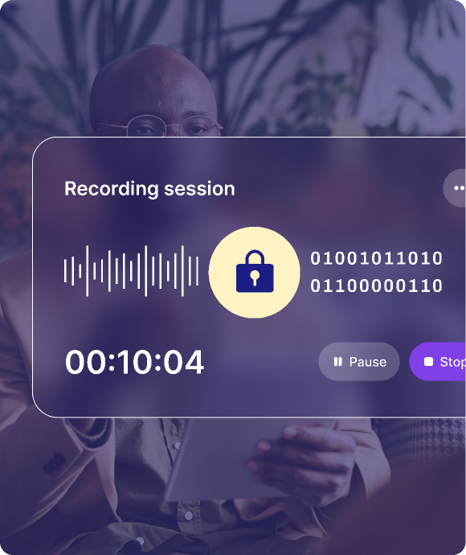
Leveraging custom illustrations and diagrams throughout the brand identity to break down complex systems, into easy to understand formats.
Here are some examples of the illustration style that JotPsych uses to visualize different systems and solutions.

Slide 25
Brand Patterns
05

Slide 26






Brand patterns can be used across a variety of media, from web design to slide decks to print media, and bring continuity and consistency to marketing materials.
Brand Pattern 1 - Small duo-tone cubes
Brand Pattern 2 - Repeating cubes

Slide 27


Brand patterns can be used across a variety of media, from web design to slide decks to print media, and bring continuity and consistency to marketing materials.
Brand Pattern 3 - Repeating transparent cubes

